Slide 1

Regional housing alliance of la plata county
The RHA's mission is to facilitate and support the preservation, rehabilitation, and development of appropriate affordable/attainable housing for the workforce essential to the long-term economic sustainability and resiliency of La Plata County and its communities.
Regional Housing Alliance of La Plata County

Slide 2
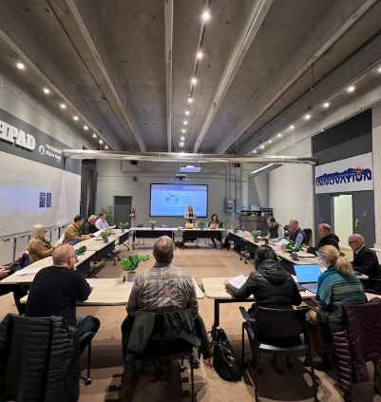
Today’s agenda
Welcome and Introductions
Recap of Previous S.T.E.E.R. Meetings
La Plata Housing Needs Assessment
Narrowed List of Funding Strategies
Legal and Financial Assessment Update
Timeline and Next Steps
Open Discussion

Slide 3

Rha history & roadmap
2004
The Regional Housing Alliance of La Plata County is a Multi-Jurisdictional Regional Housing Authority (RHA) created by an Intergovernmental Agreement (IGA) between La Plata County, City of Durango, Town of Bayfield, and Town of Ignacio.
RHA goes dormant 2017
2021
RHA board held a retreat and developed an action plan that defines goals for Leadership, Staffing, Funding, and Development.
Sixth Amended and Restated Intergovernmental Agreement (IGA) created.
2022
RHA entered an Intergovernmental 3-year (2023-2025) Funding Agreement with 4 government partners
RHA enters a Professional Services and separate Administrative Services contract with the Econ. Alliance in November
2024
Town of Ignacio awarded DOLA Local Planning Capacity Grant $192,400 one-time funds, on behalf of the RHA, to help build capacity and infrastructure for 4 government partners on Prop 123 goals for affordable housing
2025
RHA Contract Director, Eva Henson, with Soluvera LLC, focused on increasing capacity to advance RHA’s mission and DOLA grant deliverables
Regional Housing Alliance of La Plata County

Slide 4


2024 S.T.E.E.R. recap
The Alliance and RHA secured technical assistance for exploring funding source in 2024, with Project Moxie and Community Builders
January: Key stakeholders invited to convene as S.T.E.E.R. Committee
March: S.T.E.E.R. explored 3-year Workforce Investment Strategy and Peer Communities
May: Smaller taskforce explored various tax options; proposed reallocating County lodgers tax as s short-term funding solution
June: S.T.E.E.R. secured RHA support to recommend County reallocation of lodgers tax
November: Ballot Issue 1A: passed authorizing County to direct up to 70% of lodgers tax revenue toward affordable housing and childcare
Regional Housing Alliance of La Plata County

Slide 5

s.t.e.e.r. committee
Stakeholder Taskforce Evaluation and Endorsement of Revenue-streams (S.T.E.E.R.) Committee role:
Is to help the RHA explore local funding sources for below-market housing for low-to-moderate income residents.
Membership: The committee will consist of relevant community members and stakeholders, meeting over the next 3 months and reporting back to RHA Board by June 12, 2025
Outcome: Recommend a strategy to establish a countywide housing fund – or explain what it’s not feasible for 2025 and whether it could be in future years
RHA’s role: RHA is best positioned to:
It was determined that the RHA is the agency best positioned to
    Coordinate local government technical assistance
    Track countywide project pipelines and requests for interagency resources
    Implement a long-term funding source for housing initiatives in La Plata County
Funds from a potential tax would be administered by the RHA Board (representing La which is governed by a Board of Directors representing four local governments.
Regional Housing Alliance of La Plata County

Slide 6
Area Median Income and COST BURDENED
What is Affordable Housing?
The standard definition is households pay no more than 30% of their income on housing costs
Housing costs exceed 30% of income= Housing cost burdened
Housing costs exceed 50% of income= Severely housing cost burdened
What is Area Median Income (AMI)?
Area Media Income (AMI) is created by Housing and Urban Development (HUD) annually to identify what households in each county can quality for federal housing programs. Because it is so widely used, AMI is also used to create a scale for households who need help but may not qualify for federal resources. Each year HUD releases AMI charts defining need and housing entities update their programs to reflect these new household income numbers.

Slide 7

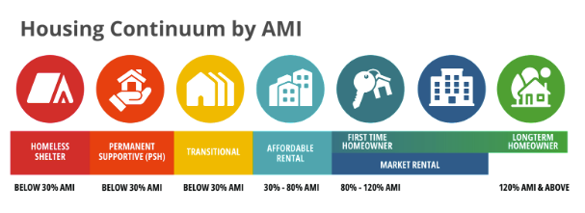
Below-Market Housing
Housing priced below typical market rates, providing options that private market doesn’t naturally offer.
This term is preferred for clarity, reducing ambiguity and avoiding assumptions about residents’ backgrounds or employment status – promoting inclusive access to housing opportunities
TERMS AND DEFINITIONS
Affordable Housing Refers to housing options that cost no more than 30% of a household’s income, making them accessible to individuals and families across various income levels, including low-to-moderate incomes.
Workforce Housing
Typically refers to housing for low-to-moderate income workers often defined at the local level
Middle Income Housing
Describes housing affordability for white-collar households
Community Housing
Focuses on affordable housing for low-to-moderate income households, with an emphasis on local residents.
Attainable Housing
Used interchangeably within these categories depending on context, generally not referring to low-income housing.
Notes:
Replace with LPC numbers.

Slide 8
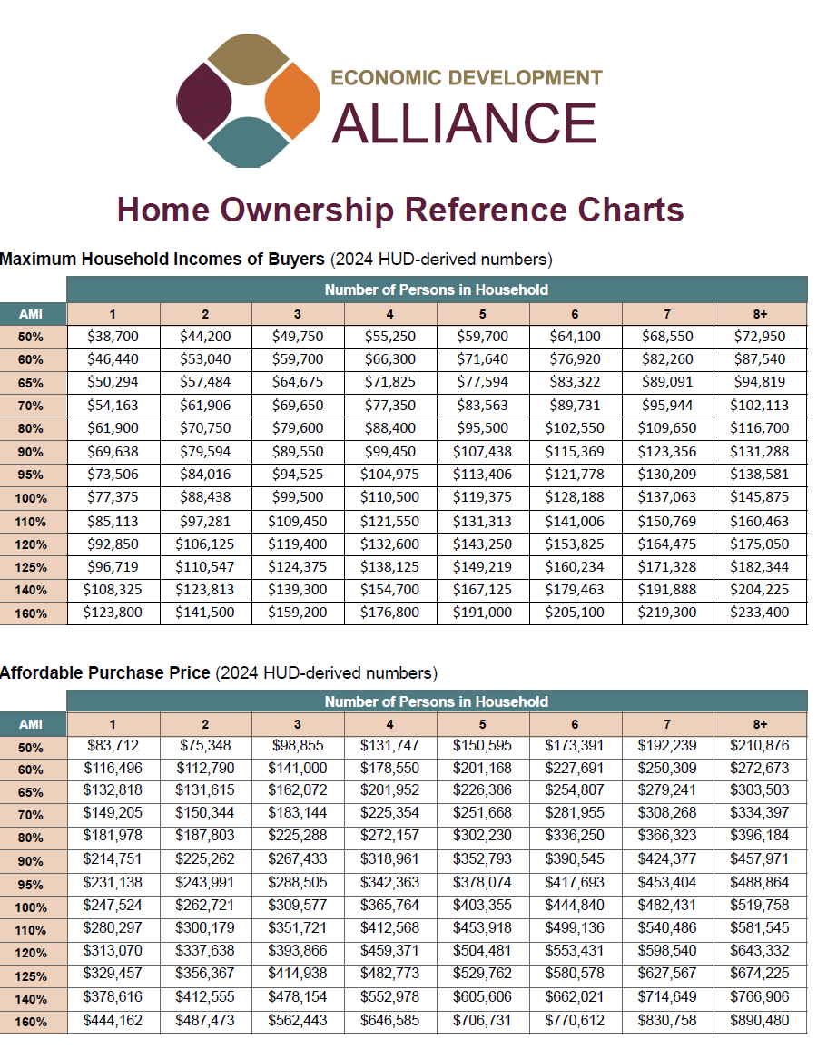
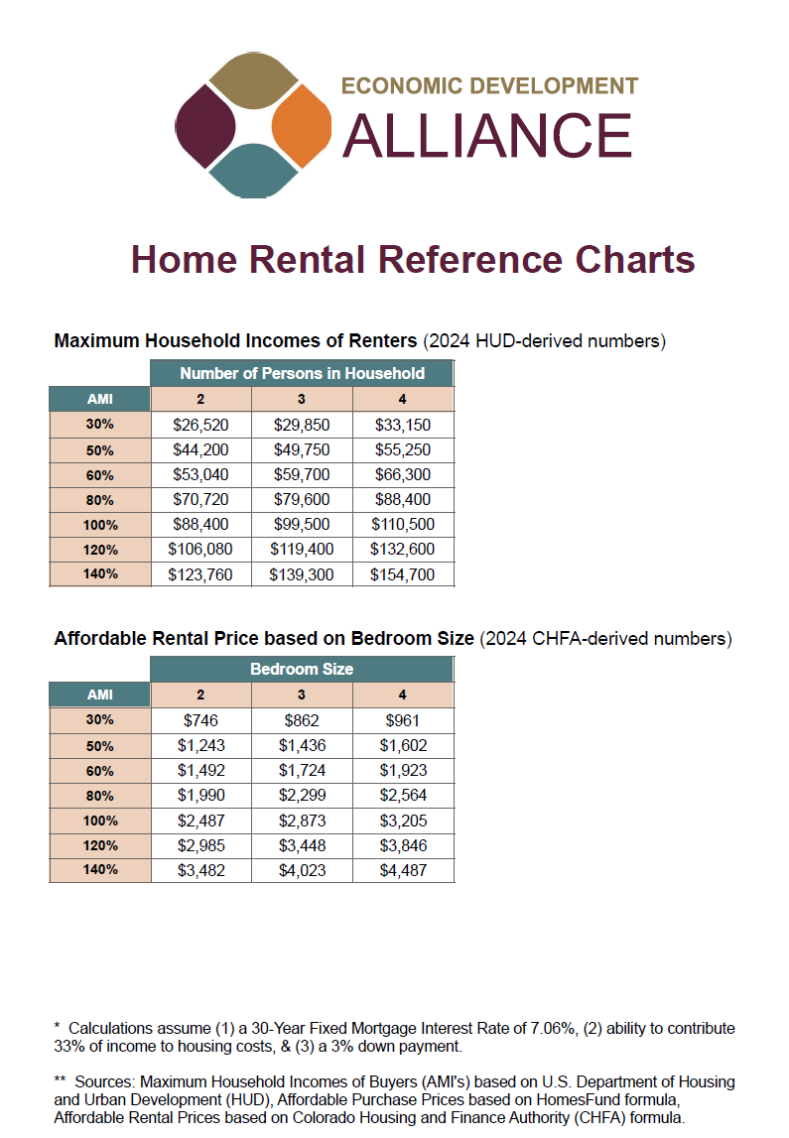
LOCAL area median income

Slide 9
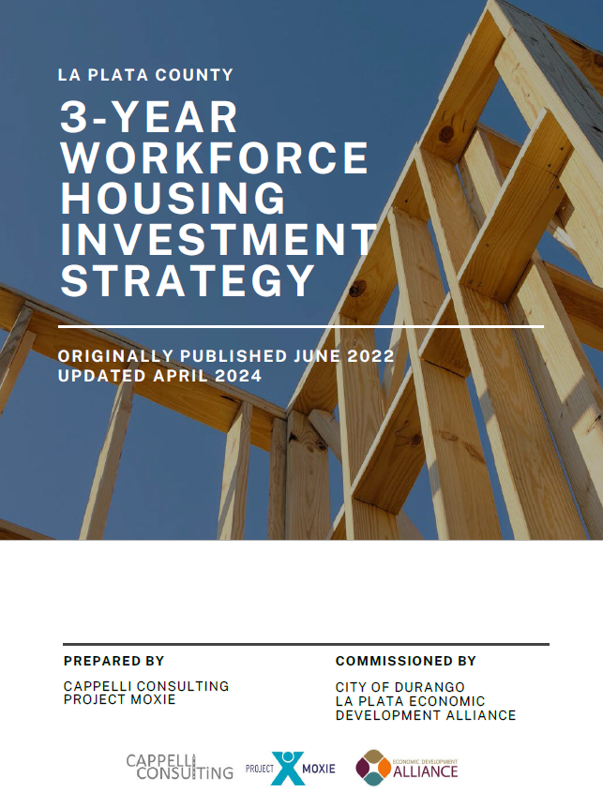
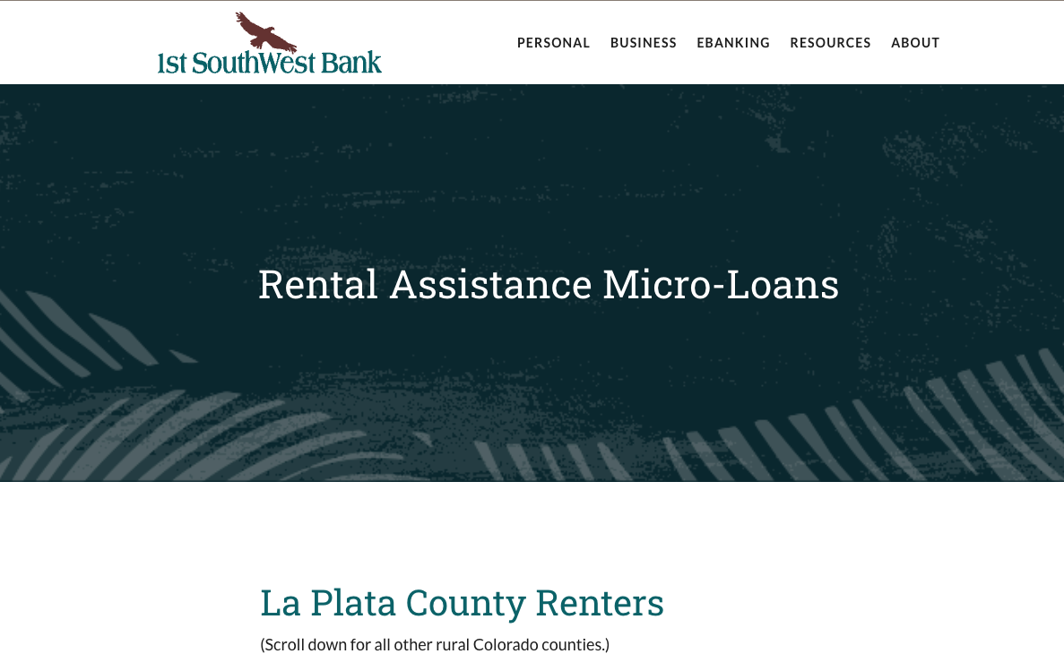


WORKFORCE HOUSING PROGRAMS

Slide 10
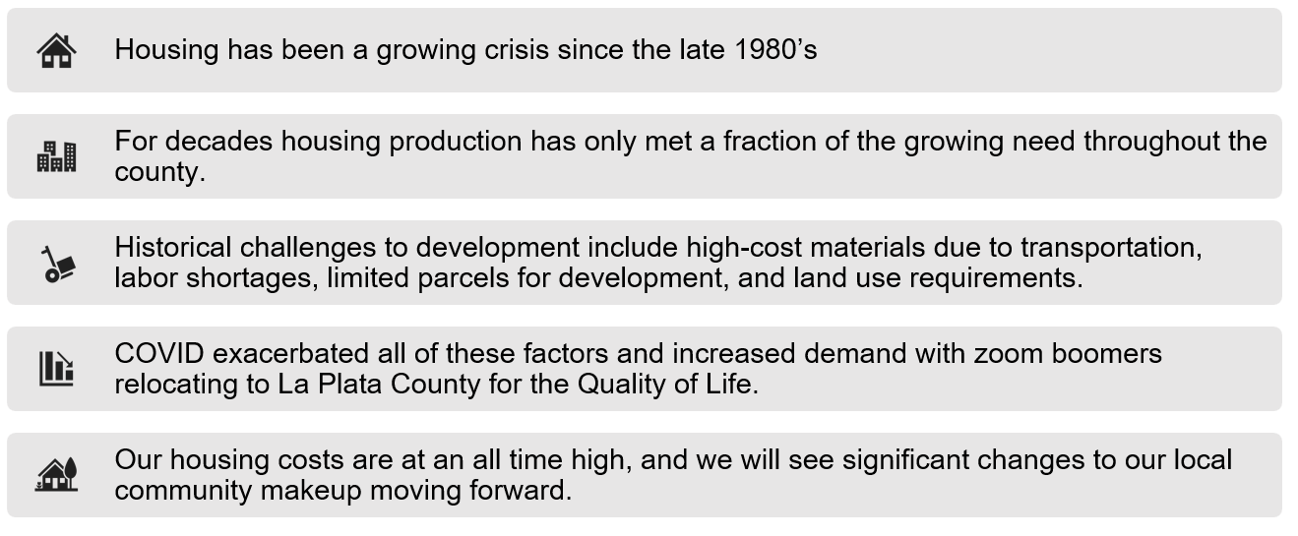
HISTORICAL HOUSING TRENDS IN LA PLATA COUNTY
La Plata County Economic Development Alliance

Slide 11
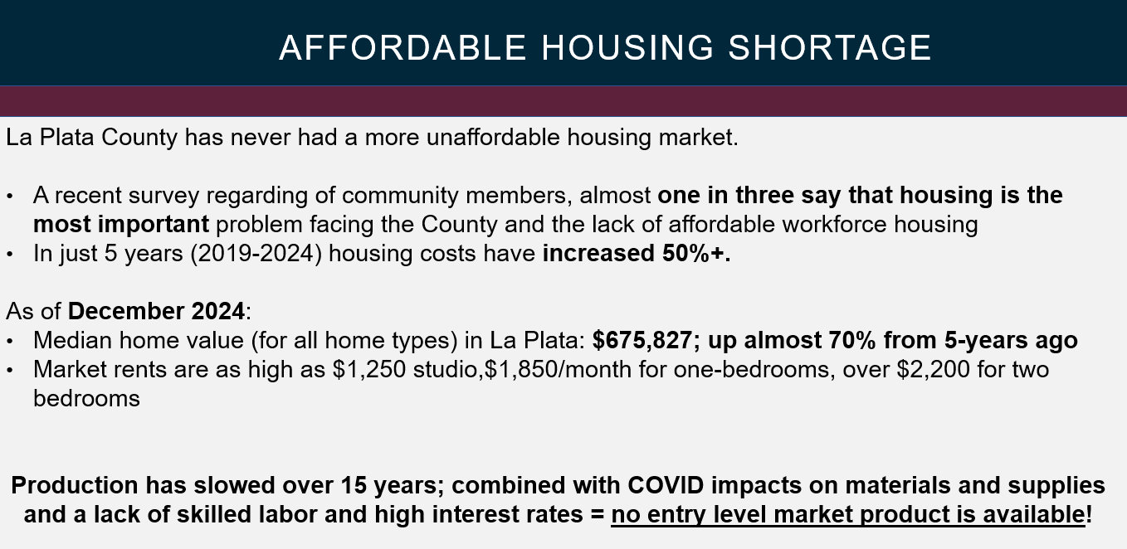

Slide 12

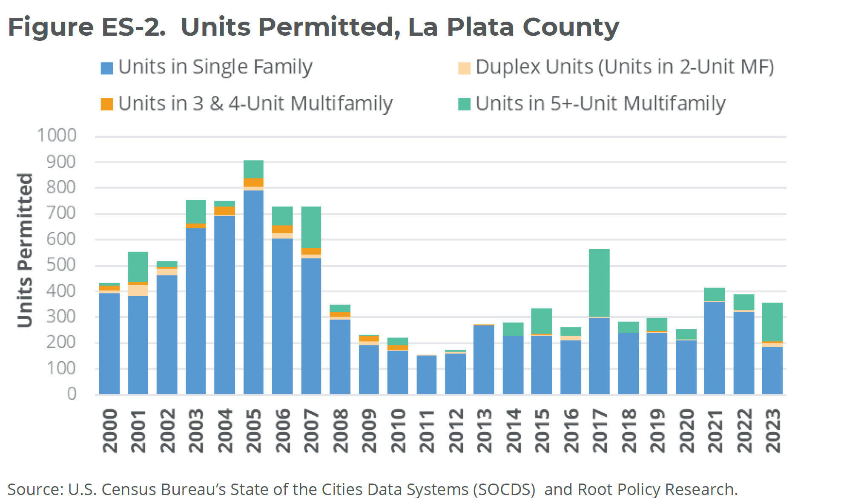
housing needs assessment
Takeaway: Since 2012, job growth has outpaced new housing production – housing supply is “not keeping up” with economic growth, creating additional pressure on the housing market and contributing to higher in-commuting
La Plata County Economic Development Alliance

Slide 13
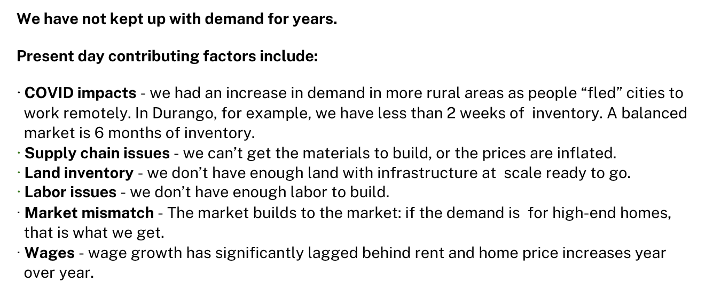
housing needs assessment
La Plata County Economic Development Alliance

Slide 14
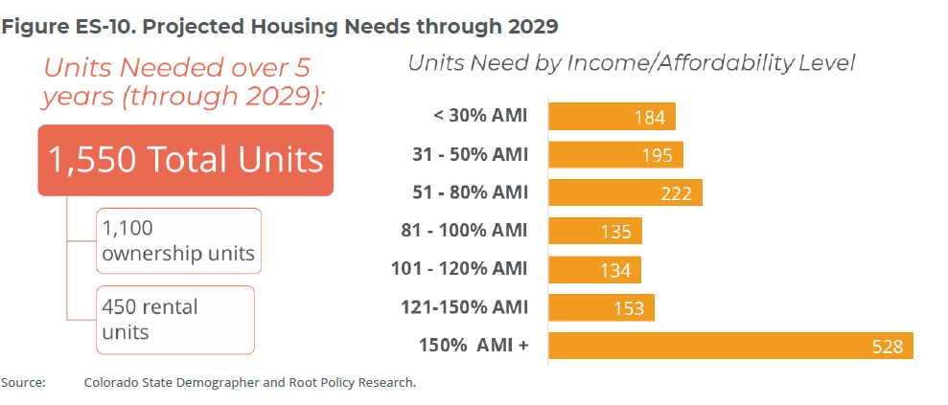
housing needs assessment
Takeaway: Current needs – mismatching in supply and demand by price point. Projected housing needs over the next 5 years with a range of <30% AMI – 150% AMI)+
RHA Focus
1,022
Total Units
La Plata County Economic Development Alliance

Slide 15
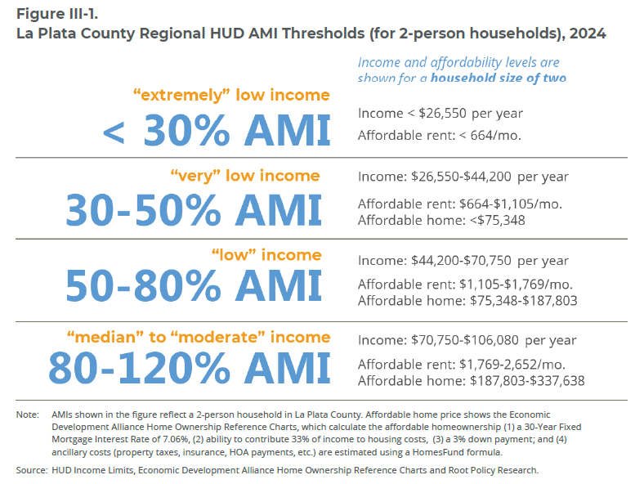
housing needs assessment
Takeaway: Importance of addressing housing needs have become a priority for local and state governments; greater support at these levels is primarily driven by the federal government’s diminishing role in providing publicly subsidized housing as well as meaningful investments from the state, non-profit and private sectors for housing projects and programs.
Supporting a balancing housing stock
Accommodates a full “life cycle community”
where there are housing options for each
stage of life from career starters through
centenarians
- this in turn supports the
local economy and contributes to La
Plata County’s community culture.
La Plata County Economic Development Alliance

Slide 16
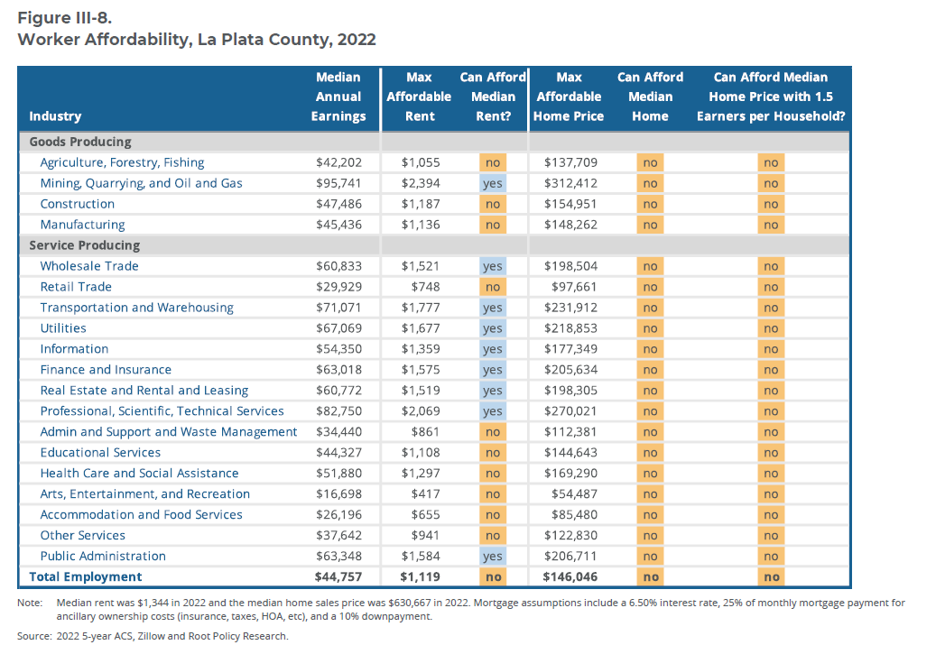
housing needs assessment
Takeaway: Essential workers cannot afford median home sales prices in City of Durango; and many are cost burdened if paying rent
Median Rent $1,344 in 2022
Median Home Price $630,667 in 2022
La Plata County Economic Development Alliance

Slide 17
housing needs assessment
Takeaway: Key solutions highlighted from stakeholder interviews and focus groups that aligns with S.T.E.E.R. efforts
  Land banking, particularly strategic purchases in the county, coupled with infrastructure investments and/or subsidies.
  Need a funding source for below-market housing to be used for gap financing, additional down payment assistance and other affordability initiatives. Specific suggestions included lodging, short-term rental tax, and/or other broad-based tax (e.g. property or sales tax).
  Regulatory and zoning changes that allow for more product diversity and innovative solutions (smaller lots, higher density, etc.)
  Streamline approval process and enhance transparency of permit/development decisions.
  Create revolving loan fund deployed through public-private partnerships on workforce development, with a funding focus on infrastructure.
  Consider public financing options that could “buy down” high interest rates.
La Plata County Economic Development Alliance

Slide 18
WHAT ABOUT ALL THIS NEW STATE FUNDING?
Voters in 2022, approved Proposition 123 that created a new $300-million-dollar state housing trust fund annually that will fund across the housing continuum.
All local governments in La Plata County opted in for Prop 123 which provides developers the opportunity to apply for these new state funds for their housing projects. However, each project will need to identify match funds to be competitive. Some funding can go to local government (land banking) but most will be deployed through a competitive process requiring a feasible project that is well defined.
Prop 123 is an incredible new funding source but its oversubscribed and will not meet all the pent-up demand across the state.
2024, up to $70,000 a unit that meets the Prop 123 affordability requirements.
We need local, flexible funds to do things state funds can’t do and to ensure we are more competitive for these state funds when our projects apply.
La Plata County Economic Development Alliance

Slide 19

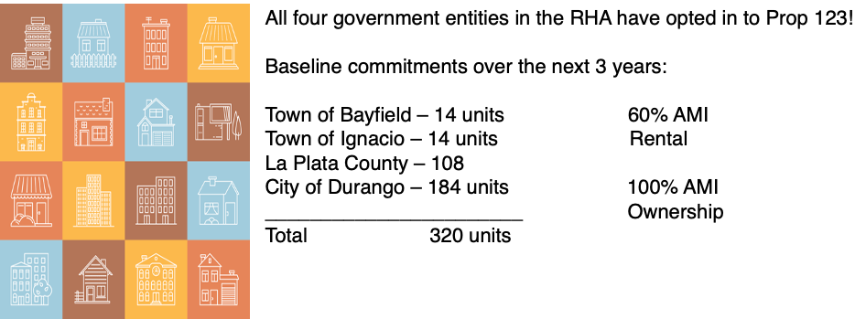

PROP 123
La Plata County Economic Development Alliance

Slide 20

The Role of Local Funding
Notes:
Carolyn + Clark

Slide 21

The Role of Local Funding
Key Benefits
Flexible and adaptable
Leverages more money
Provide matching funds
Creatively fill gaps
Creates long-term community assets
Impacts accrue over time
Puts the community in control
Increasingly essential to progress

Slide 22
Common Uses of Local Funding
Acquisition + Preservation. Land, Buildings, MHPs, Motel Conversion.
Rehabilitation and Adaptive Reuse.
Capital Investment. Infrastructure, Utilities
Match / Leverage Funding. LIHTC, Grants, etc.
Gap Finance. Direct subsidies. P3s. Pre-development. etc.
Programs. Mortgage Assistance. Buy-Downs. Education. Incentives.
Insurance on condo construction.
Capacity. Ability to do the work…

Slide 23
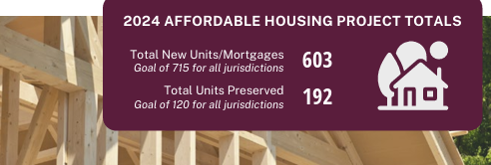
WORKFORCE HOUSING STRATEGY
Workforce Housing 3 Year Investment Strategy for La Plata County
  Published June of 2022 and Updated April 2024
  6 Strategies for addressing housing need for the Missing Middle – Workforce (Area Median Income (AMI) 80%-125% or $70,750 - $110,547 for a two-person household)
    1. Rental
    2. Homeownership
    3. Support Resources for Infrastructure Develop
    4. Preservation
    5. Local Housing Trust Fund
    6. Ongoing Education and Advocacy
La Plata County Economic Development Alliance

Slide 24
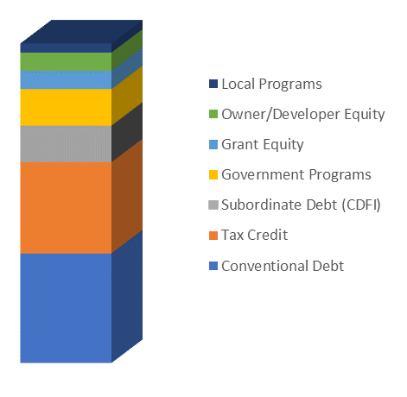
Local Funding Helps Unlock Other Gap Fillers
GAP

Slide 25
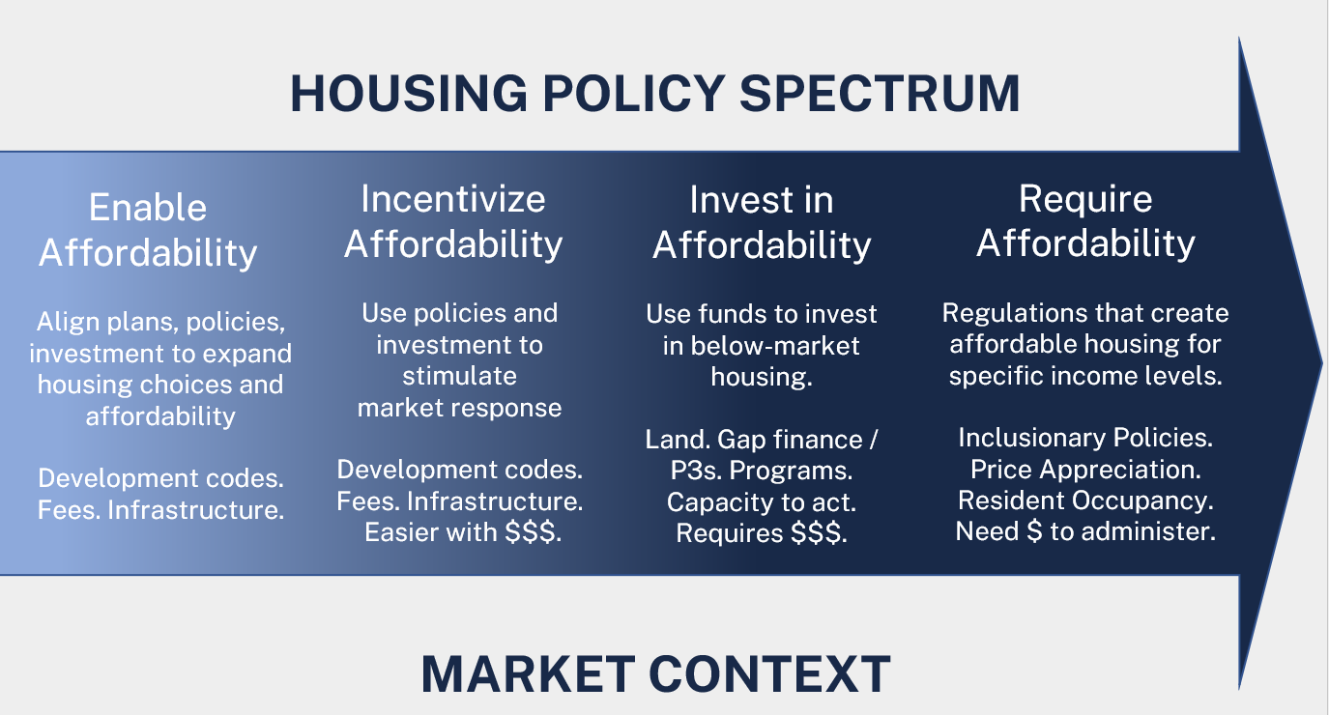

Slide 26
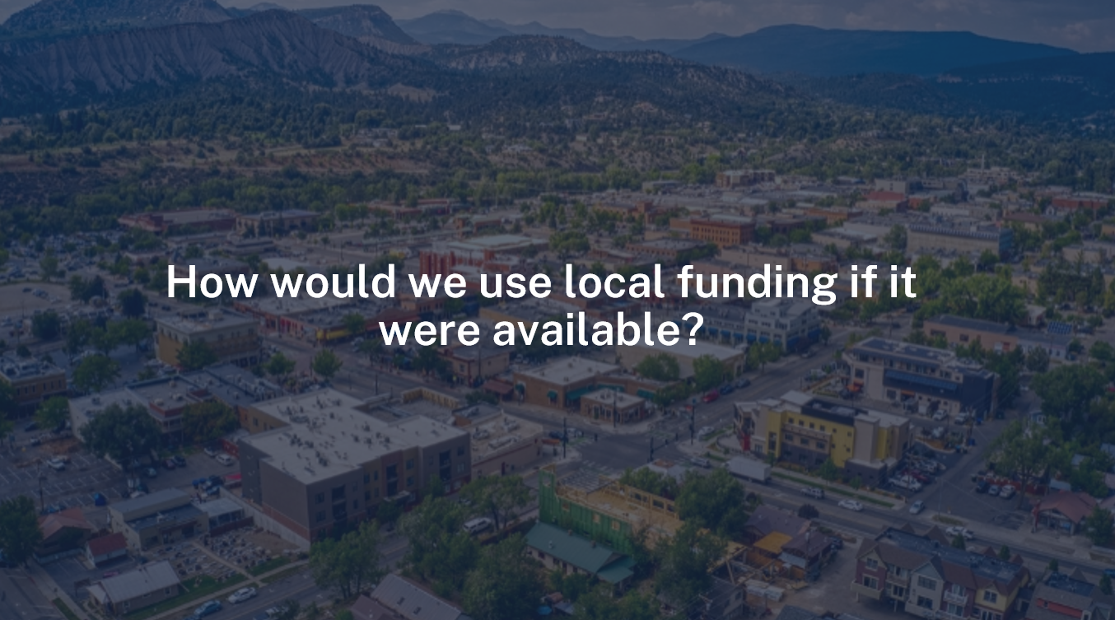

Slide 27
RHA PRIORITIES
Dedicated Local Funding + Resources
RHA Operations – Staff (3)
(Exec. Director/Housing Coordinator)
Programs: FSWB Rental Micro-loans
Catalyst Fund – predevelopment costs
Catalyst Revolving Loan Fund – low interest loans
Land Acquisition & Banking Fund
State and Federal Grants – local match requirement
What RHA should NOT Focus on Right Now:
Being a Developer of direct projects
Other Opportunities
Policy Research & Development – advocate for policies for below-market housing
Community Engagement – education, forums, surveys to gather public input
Technical Assistance and Resources – help navigate funding and regulatory processes
Foster and facilitate public-private partnerships to leverage private investment for affordable housing
Multi-jurisdictional Collaboration – work across municipal boundaries to coordinate regional solutions
3-year Workforce Investment Strategies

Slide 28
$2 million
annually
RHA Operations: $500,000
Executive Director
Housing Programs & Communications Manager
Administrative & Finance Coordinator
General Operating & Financial Systems
Catalyst Fund: $400,000
Catalyst Revolving Loan Fund: $500,000
Land Acquisition & Land Banking: $500,000
Other Opportunities
Resources/Programs/Support
$100,000
Key Staff Positions:
Executive Director
Leadership & Strategic Oversight
Regional Collaboration & Advocacy
Research & Policy Management
Housing Programs & Communications/Finance Manager
Program Management & Grant Administration
Community Engagement & Outreach
Financial Tracking & Reporting
Operations & Systems Coordinator
General Operations & Office Management
Financial Systems & Compliance
Administrative Support

Slide 29

RHA VALUE & REGIONAL ROLE
Convener & HUB for Regional Collaboration
Address Funding Needs & Administer Local Funds
Capacity for Regional Housing Work
Pursuing Opportunities (pursuing grants, technical assistance)
Policy Development Assistance & Pipeline Coordination
Data & Research HUB for Regional Housing
Pre-development Assistance & Pipeline Coordination
8. Foster Public Private Partnerships
9. Community Engagement & Inclusive Outreach
10. Education & Capacity Building
11. Resource Pooling & Risk Management Tools
12. Promote Sustainable, Long-term Affordability
13. Land Banking & Strategic Site Control
14. Elevate Awareness & Support for Housing

Slide 30


Slide 31
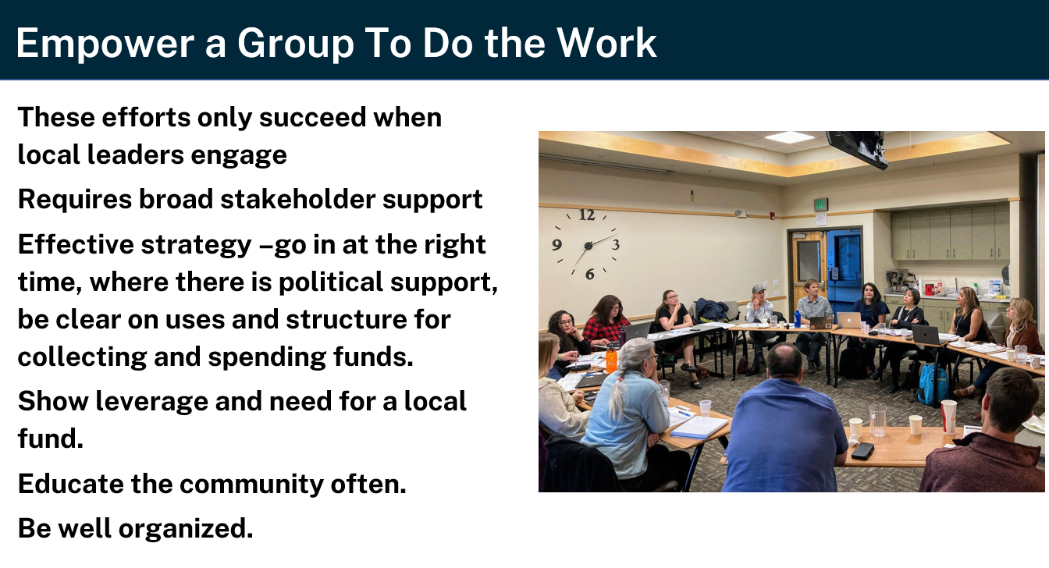

Slide 32
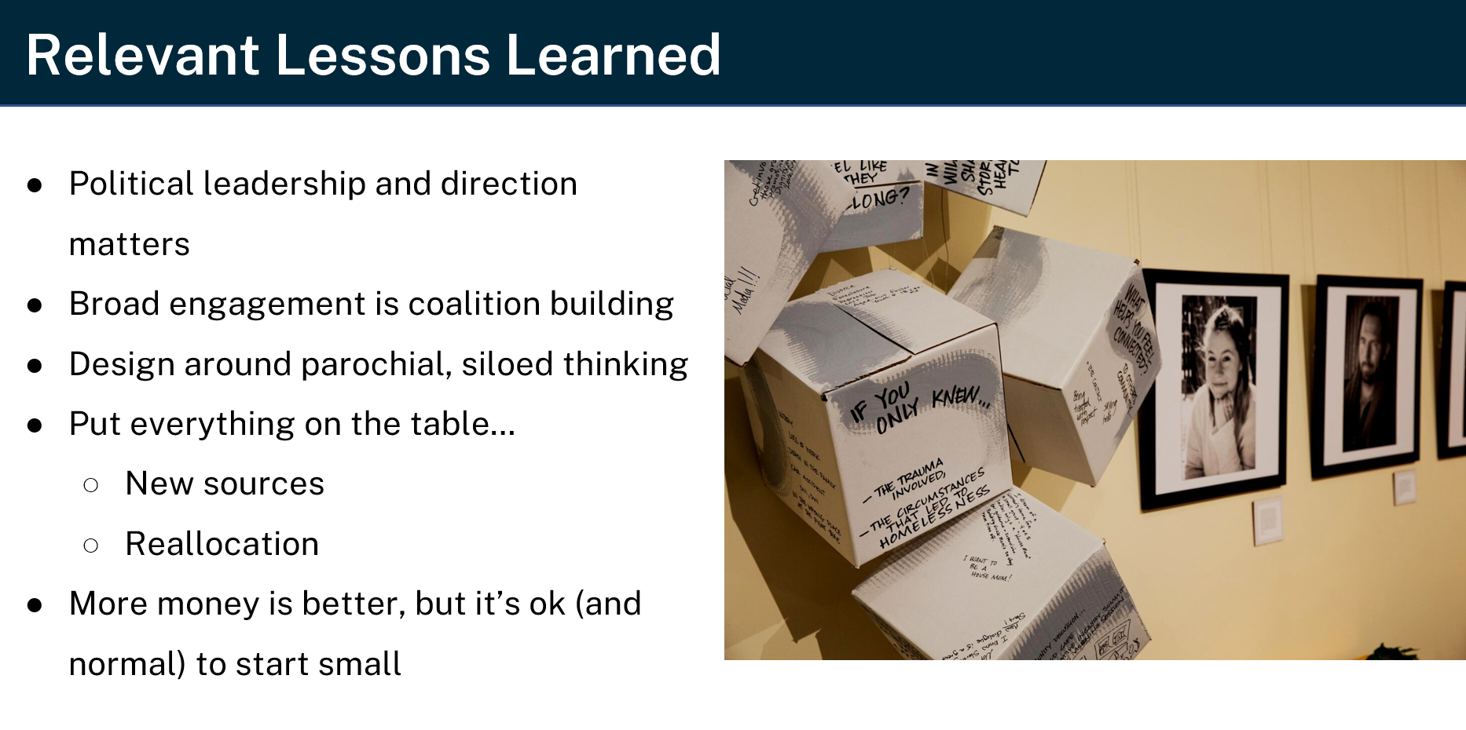

Slide 33
S.T.E.E.R. COMMITTEE ROLE
Help answer a series of questions —
Review narrowed list of public funding sources?
What are the pros and cons of these different sources?
What community engagement and education is needed to build support for a public funding strategy?
How would a public fund for housing be administered?
What could the eligible uses be?
At the end of our time together; the S.T.E.E.R. committee would make formal recommendations to the RHA board regarding this issue.

Slide 34
S.T.E.E.R. Goals: Evaluation and Endorsement Process
Clarify Housing Needs: Leverage insights from the new La Plata Housing Needs Assessment to identify and quantify priority housing gaps across income levels and community segments.
Connect Needs to Revenue-streams: Explore the narrowed list of funding strategies, assessing their alignment with identified housing needs and capacity to support long-term sustainable solutions.
Evaluate Feasibility and Impact: Assess the financial, legal, administrative feasibility of each revenue option, considering implementation requirements and potential barriers.
Weigh Long-Term Viability: Compare the short-and long-term potential of each revenue stream, evaluating factors like revenue stability, growth potential, and adaptability to evolving housing demands.
Build Toward Endorsement: Synthesize findings into a clear set of recommendations, guiding the selection of the most viable and impactful funding options for stakeholder endorsement and future action.

Slide 35
Public Funding & Revenue-stream Sources
Source | Overview | Voter Approval | Pros / Strengths | Cons / Challenges
Reallocation of Lodgers Tax: County | Counties are currently capped at 2% New 2025 legislation to increase from 2% to 6% | Yes, but no RHA Action | Existing Tax with City and County 1A passed in November If legislation is successful: 2 ballot questions needed To increase % & For what purposes | Timing needs to be considered Funds will vary/hard to predict Are vacation rentals regulated by the County? What about Bayfield/Ignacio?
Sales Tax | Can create new sales tax, increase an existing sales tax, or reallocate from a sales tax to a new purpose | Yes, RHA can submit a ballot question to voters Is the County seeking a countywide tax question for road and bridge? A bundled question could be an approach for the region | Spreads the burden to up valley residents and others from around the region including tourists Touches visitors as well as locals Raises more money Can be regional Can be time limited Community investment: demonstrates local commitment to addressing housing challenges Community driven impact: the revenue can be used to directly fund housing solutions that make living in the community more affordable | Political sensitivities Ballot timing Optics of going from zero funding to potentially a lot could be challenging Economic fluctuations Equity concerns: sales tax can be considered regressive meaning lower-income residents may feel a disproportionate impact Optics of going from zero funding to potentially a lot could be challenging
Development Impact Fee | Must be combined with sales/use tax, property tax, or both | Yes, RHA can submit a ballot question to voters but must be combined with another tax | One-time charges on new development and can be used to offset affordable housing Has been successful in other mountain towns Can be a unique approach to large sq. ft. homes | May need nexus study Must be attached to a sales tax/use tax, property tax, or both
Property Tax – County Mill Levy | Tax collected by property owners in jurisdiction | Yes, but no RHA Action Yes, County/City/Towns/RHA (May need to have legal explain) | Touches owners, visitors, 2nd homeowners as well as locals Funds have to go to a designated source (RHA could ask it as a special district entity); Mill levies are generally low in CO | Tax increase could be seen as regressive Property taxes influence costs of buying, renting, or investing in homes and apartment buildings

Slide 36
Proposed Timeline & Next Steps
Meeting 1 (early March): Overview of new La Plata Housing Needs Assessment, review current housing challenges, introduce narrowed list of potential revenue streams, and set expectations for upcoming meetings.
Meeting 2 (late March): Dive deeper into specifics of potential revenue streams, discuss feasibility, and begin evaluating pros and cons. Review early findings from legal and financial assessments.
Meeting 3 (mid/late April): Finalize revenue stream options, refine pros and cons, and prepare recommendations. Review final legal review and financial analysis on potential revenue streams and funding mechanisms.
Meeting 4 (May): Convene to finalize the committee's findings on whether a local funding source is feasible and make final recommendation.

